Slide 1
Capstone Project
Telecom Churn Analysis

Slide 2
Content
• Team Information
• Business Problem Overview
• Objective
• Analysis Based on:
• Area Code
• States
• International Plan
• Voice Mail Plan
• Customer Service Calls
• Challenges
• How to Reduce Customer Churn
• Conclusion

Slide 3
Team Information
Student Email Id: | Student Name:
chandanraxit2468@gmail.com | Chandan Kumar Raxit
jdeepakkumar986@gmail.com | Deepak Kumar Jena

Slide 4
Business Problem Overview
• Customer churn prediction is extremely important for any business as it recognizes the clients who are likely to stop a using their services.
• In the telecom industry, customers are able to choose from multiple service providers and actively switch from one operator to another. In this highly competitive market, the telecommunications industry experiences an average of 15-25% annual churn rate.
• For many incumbent operators, retaining high profitable customers is the number one business goal.
• To reduce customer churn, telecom companies need to predict which customers are at high risk of churn.
• In this project, we will analyze customer-level data of a leading telecom firm, to identify customers at high risk of churn and identify the main indicators of churn.

Slide 5
Objective
Finding factors which influence customers to churn.
Retain churn customers by applying strategy.
Providing offers based on influencing factors.
Control churn rate and improve the image in the market.

Slide 6
Data Summary
Data set : Telecom Churn dataset of Orange S.A., formerly France Telecom S.A.
Shape:
– Rows - 3333
– Columns – 20
Important Columns: State, Area code, International plan, Voice mail plan, Churn, Customer service calls, Total eve calls, Total day calls, Total night calls, Total intl calls.( Probably all columns are important ).

Slide 7
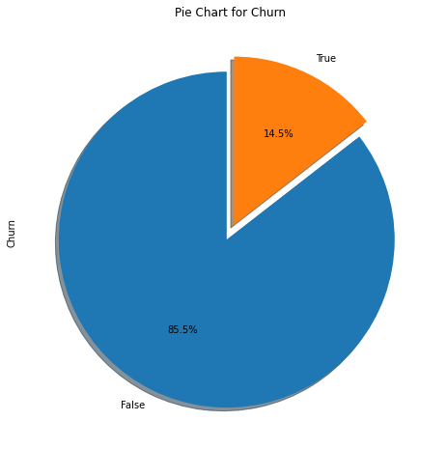
Churn Information
Total Users were 3333.
2850 - Non churn (85.5%)
483 - Churn (14.5%)

Slide 8
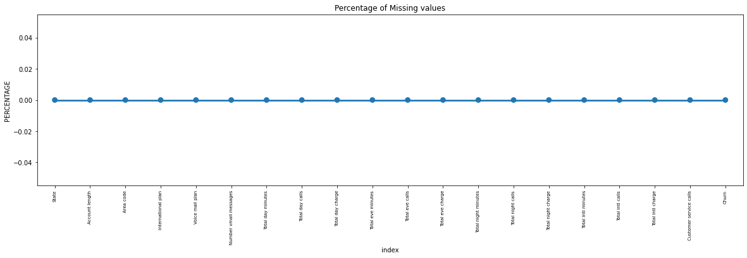
Percentage of Missing Values

Slide 9
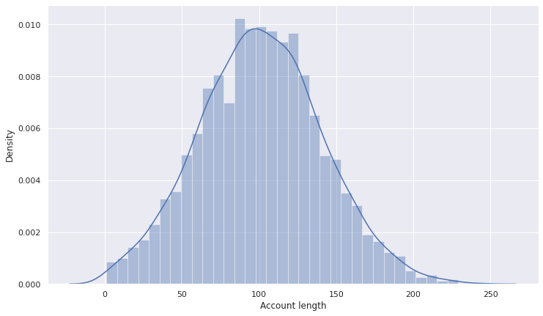
Analysis based on Account Length

Slide 10
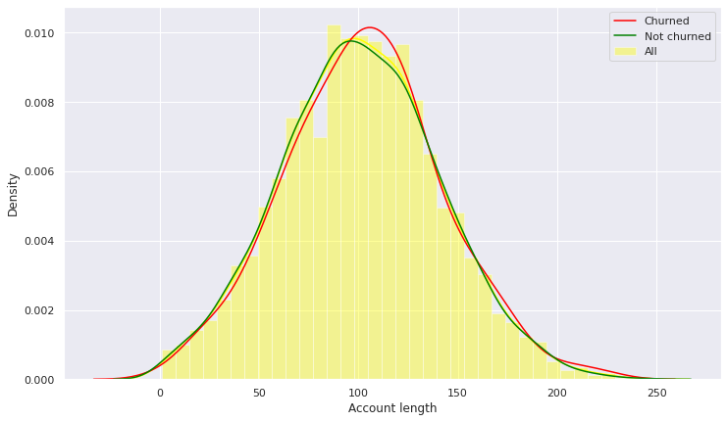
comparison of churned account length and not churned account length
After analyzing various aspects of the "account length" column we didn't found any useful relation to churn. so we aren't able to build any connection to the churn as of now. let's see what other features say about the churn.

Slide 11
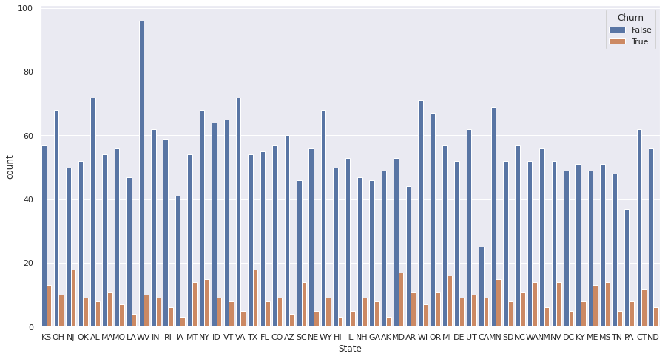
Analysis based on States
There are 51 state who have different churn rate. CA, NJ ,TX , MD ,SC ,MI are the ones who have higher churn rate more than 21.74% which is more than 50% of average churn rate.

Slide 12
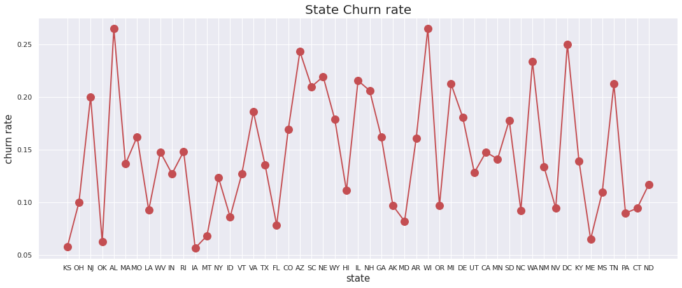
State Churn rate

Slide 13
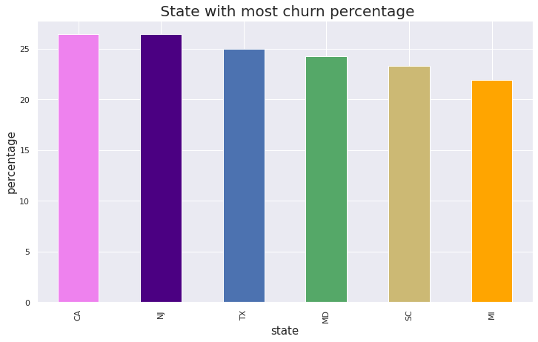
State with most Churn percentage

Slide 14
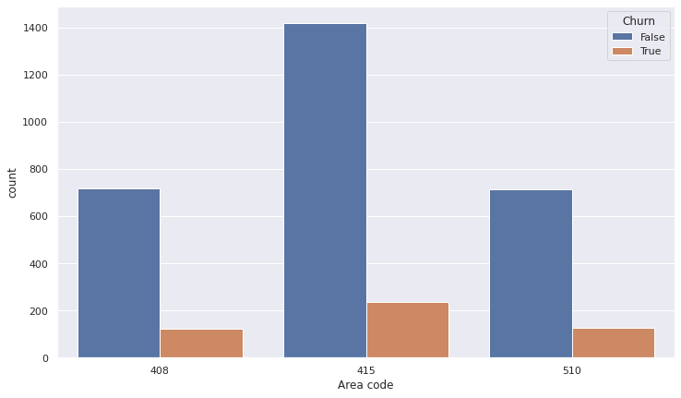
Analysis Based on Area Code
All the Area codes have almost equal (.14%) percentage of Churners.

Slide 15
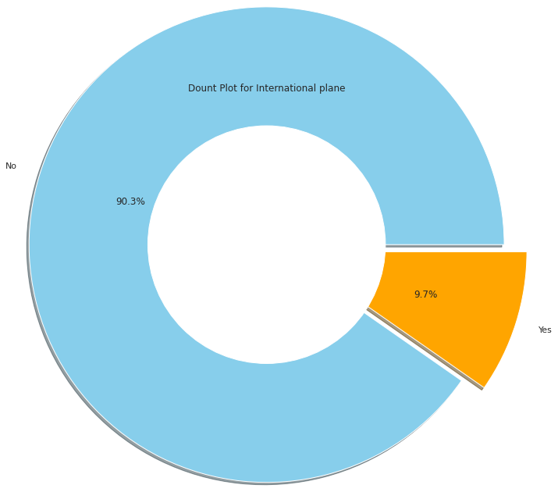
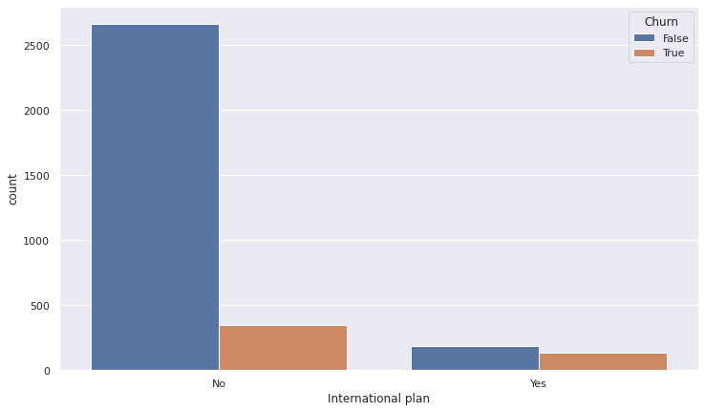
Analysis Based on International Plan

Slide 16
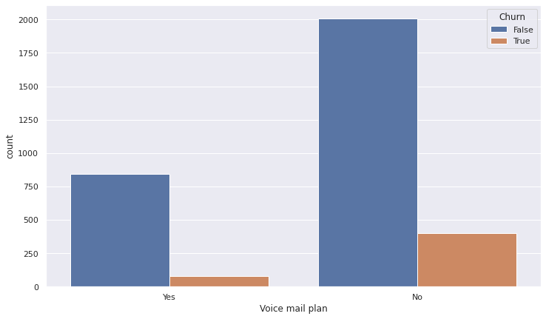
Analysis Based on Voice mail

Slide 17
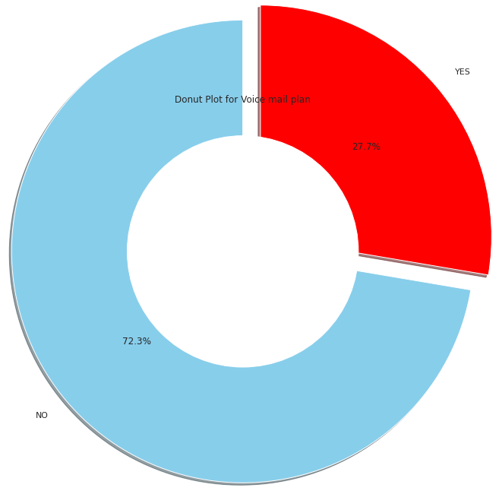
Out of 3333 people 922 having Voice mail plan, rest 2411 do not have any Voice mail plan.

Slide 18
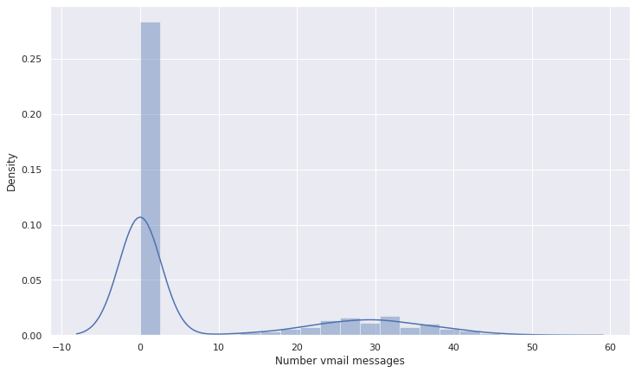
Analyzing "Number vmail message" column

Slide 19
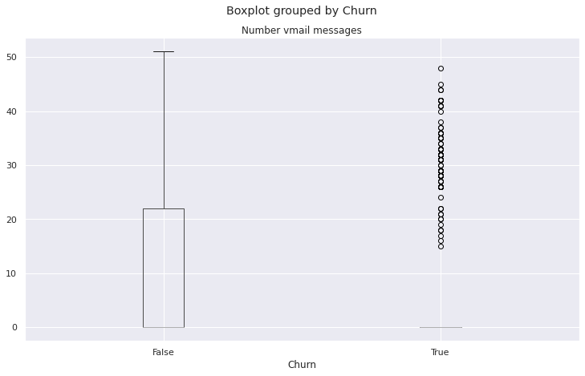

Slide 20
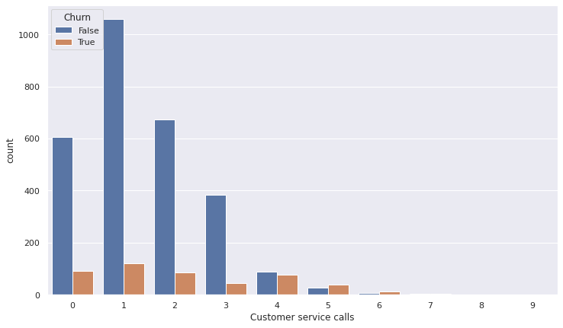
Analysis based on Customer Service Call

Slide 21
It is observed from the above analysis that, mostly because of bad customer service, people tend to leave the operator.
The above data indicating that those customers who called the service center 5 times or above those churn percentage is higher than 60%
And customers who have called once have a high churn rate indicating their issue was not solved in the first attempt.

Slide 22
Pair Plot For All Columns

Slide 23
Challenges
Difficult to recognize columns like- (Account Length , Number vmail messages. Etc.) as while subset these we got lot of possibilities of true churn and have to work for each possibilities.
Need to plot lot of Graph for different States as well as different Area codes to understand the data and handling the data.
Need to subset for respective State having respective Area code till it reaches a dozen of customers.

Slide 24
Solution to Reduce Customer Churn
▪ Modify International Plan as the charge is same as normal one.
▪ Be proactive with communication.
▪ Ask for feedback often.
▪ Periodically throw Offers to retain customers.
▪ Look at the customers facing problem in the most churning states.
▪ Lean into best customers.
▪ Regular Server Maintenance.
▪ Solving Poor Network Connectivity Issue.
▪ Define a roadmap for new customers.
▪ Analyze churn when it happens.
▪ Stay competitive.

Slide 25
Conclusion
• The four charge fields are linear functions of the minute fields.
• The area code field and/or the state field are anomalous, and can be omitted.
• Customers with the International Plan tend to churn more frequently.
• Customers with four or more customer service calls churn more than four times as often as do the other customers.
• Customers with high day minutes and evening minutes tend to churn at a higher rate than do the other customers.
There is no obvious association of churn with the variables evening calls, night calls, international calls, night minutes, international minutes, account length.

Slide 26


